Slide 1
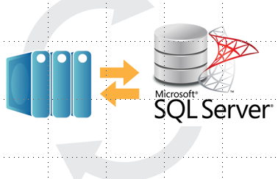

A Database Backup Is Useless If You Can't Restore It
Joe Gavin

Slide 2
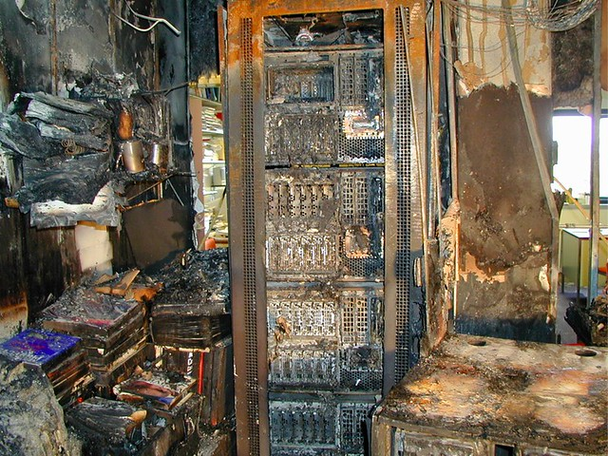
Database Restore Failure
What are the repercussions of not being able to restore a backup?
Lost $$$
Lost confidence
Lost employment?

Slide 3

Verify your backups - NOW!
https://www.red-gate.com/products/dba/sql-backup/resources/verify-backups-now

Slide 4
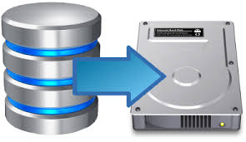
Agenda
Recovery models
Backup types
dbatools
Backing up databases
Testing backups by restoring them
Automating restore testing

Slide 5
Database Recovery Models
Full
Recoverability to an arbitrary point in time
Transaction Log Backups are required
Simple
Transaction Log cannot be backed up
Transaction Log is truncated on checkpoint

Slide 6
Types of Database Backups
Full
Entire database
Foundation for Differential and Transaction Log restores
Transaction Log
Serial backup of all transactions since the last transaction log backup
Differential
Changes made since the last full backup

Slide 7
RPO / RTO
Recovery Point Objective (RPO)
Amount of data (measured in time) that the business can afford to lose
Recovery Time Objective (RTO)
Time from the beginning of the outage to the time the everything is operational again

Slide 8
Database Backups
12A Full
4A Log
12P Diff
2P Log
4P Log
6A Log
6P Log
8P Log
10P Log
8A Log
10A Log
2A Log

Slide 9
Database Failure at 9:00 AM
12A Full
4A Log
12P Diff
2P Log
4P Log
6A Log
6P Log
8P Log
10P Log
8A Log
10A Log
2A Log
9A Fail

Slide 10
Database Failure at 5:00 PM
12A Full
4A Log
12P Diff
2P Log
4P Log
6A Log
6P Log
8P Log
10P Log
8A Log
10A Log
2A Log
5P Fail

Slide 11
Test Restores at 11:00 PM
12A Full
4A Log
12P Diff
2P Log
4P Log
6A Log
6P Log
8P Log
10P Log
8A Log
10A Log
2A Log
11P Test

Slide 12





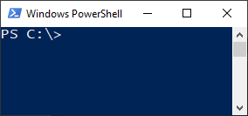
dbatools
dbatools.io

Slide 13
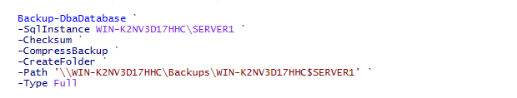
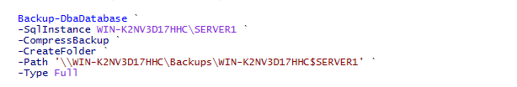
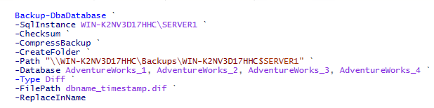
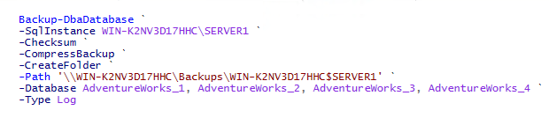
Backup-DbaDatabase

Slide 14
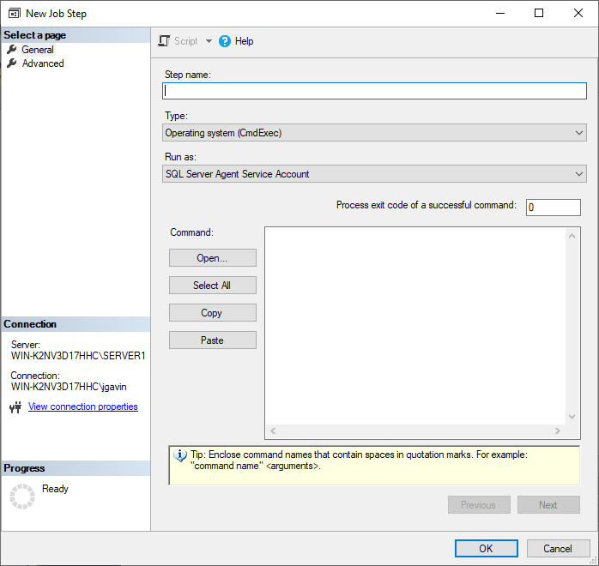

Schedule Backup-DbaDatabase

Slide 15

Test-DbaLastBackup
Restores a backup to destination
Runs DBCC CHECKDB
Drops restored test database
Repeats for each database
Outputs results
Source
Destination
Latest backup information from source

Slide 16

Requirements to Run Test-DbaLastBackup
dbatools
‘Install-Module dbatools’ from an elevated PowerShell session to install
Destination SQL Server at or above highest version you’re testing

Slide 17

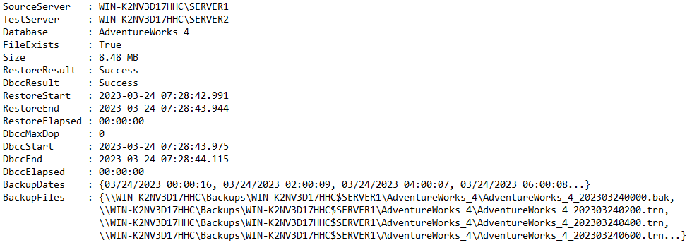
Run Test-DbaLastBackup

Slide 18




BackupValidation.ps1 Requirements
Edit server list in text file without editing script
All configuration done in variables
Run it on a schedule with a SQL Agent Job
Get an email with a .csv of the results

Slide 19
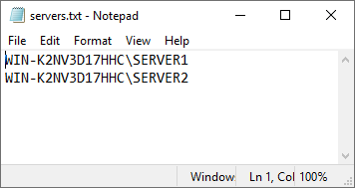
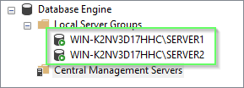
Server List

Slide 20
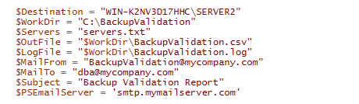
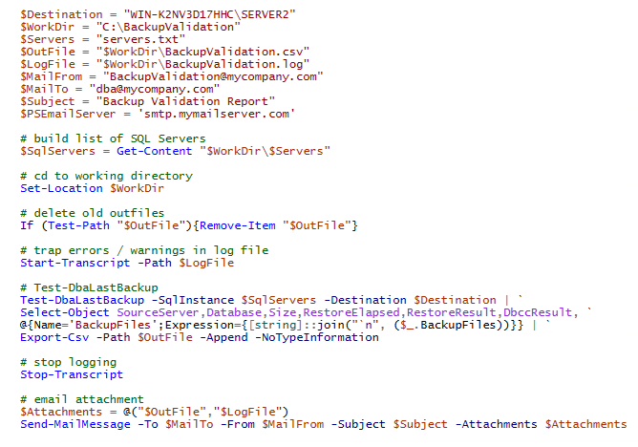
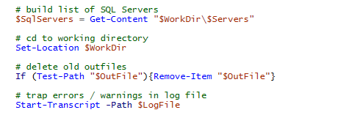

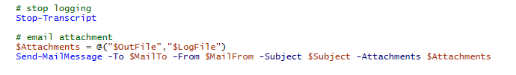
BackupValidation.ps1

Slide 21
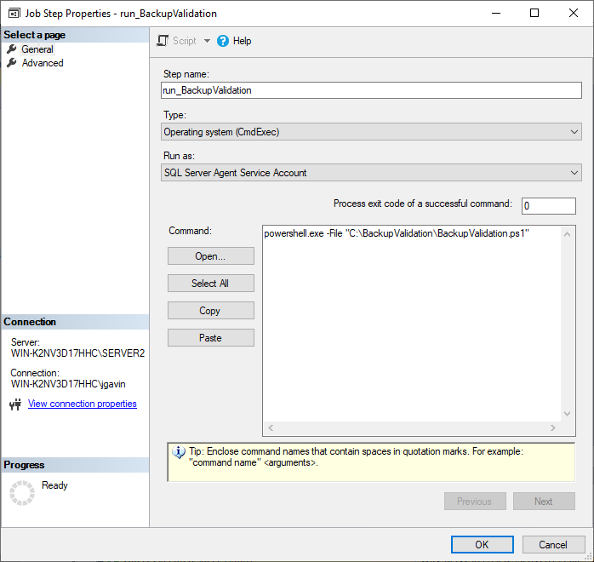
SQL Agent Job

Slide 22
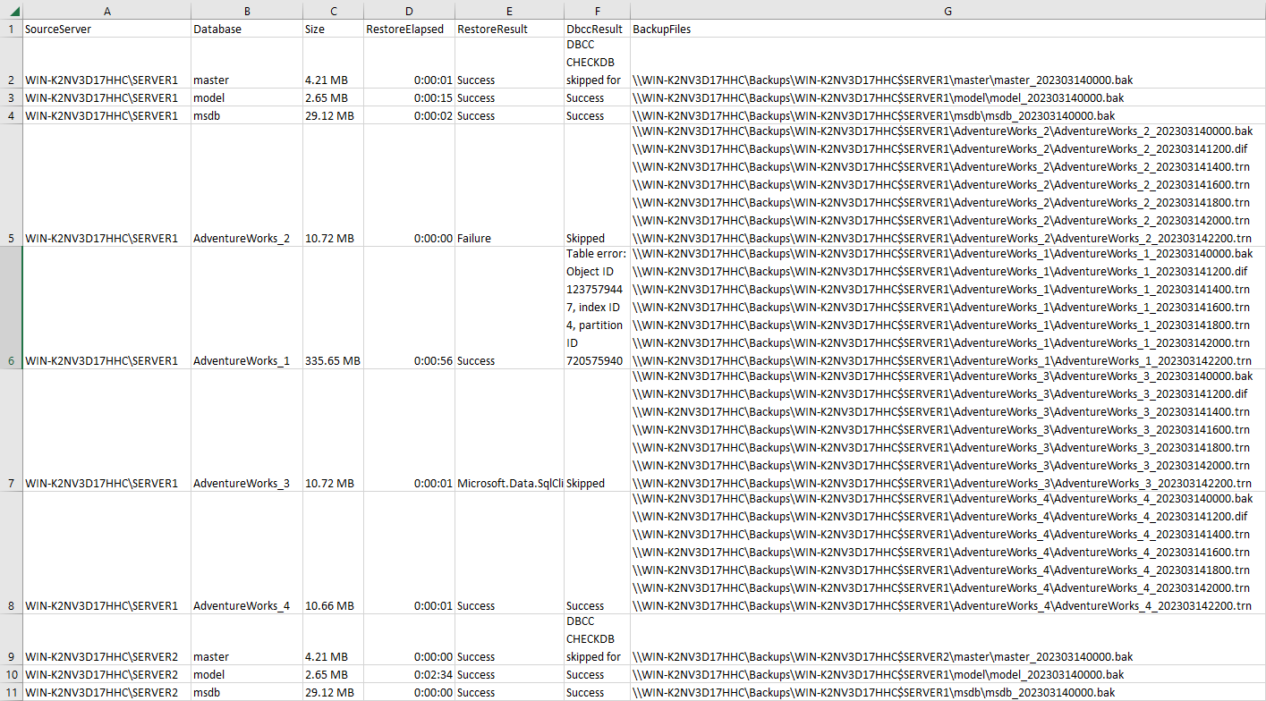
Output File
`

Slide 23
Output File

Slide 24
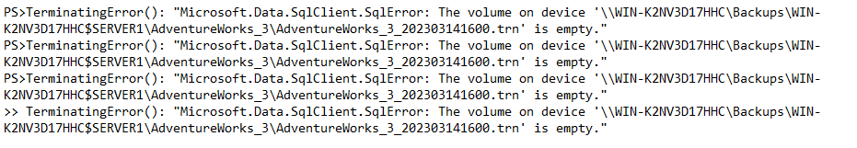
Output File

Slide 25

Output File

Slide 26
Test-DbaLastBackup Partial List of Optional Parameters
-Database -ExcludeDatabase
-IgnoreDiffBackup -IgnoreLogBackup
-NoCheck -NoDrop
-Prefix -VerifyOnly

Slide 27
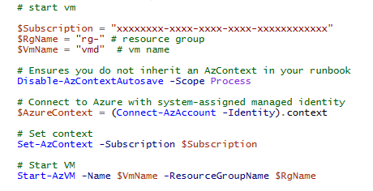
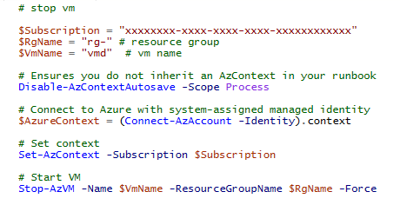
Azure Runbooks to Start / Stop VM

Slide 28

Summary
Reviewed Recovery Models / Backup Types
Manually run Test-DbaLastBackup
Wrap Test-DbaLastBackup in a script to automate backup validation and reporting
How to interpret errors if they occur
Switches to further customize script
Start / stop an Azure VM

Slide 29

Thank You
Email: joe@joegavin.net
Twitter: @joegavin02180
LinkedIn: www.linkedin.com/in/joegavin/
GitHub: https://github.com/joegavin/presentations

